Slide 1

CSCE 692 - Design Principles of Computer Architecture
Memory Hierarchy Design
(Caching)
Appendix B,
Chapter 2
Dr. Scott Graham
AFIT/ENG
Notes adapted from:
David Patterson
University of California, Berkeley

Slide 2
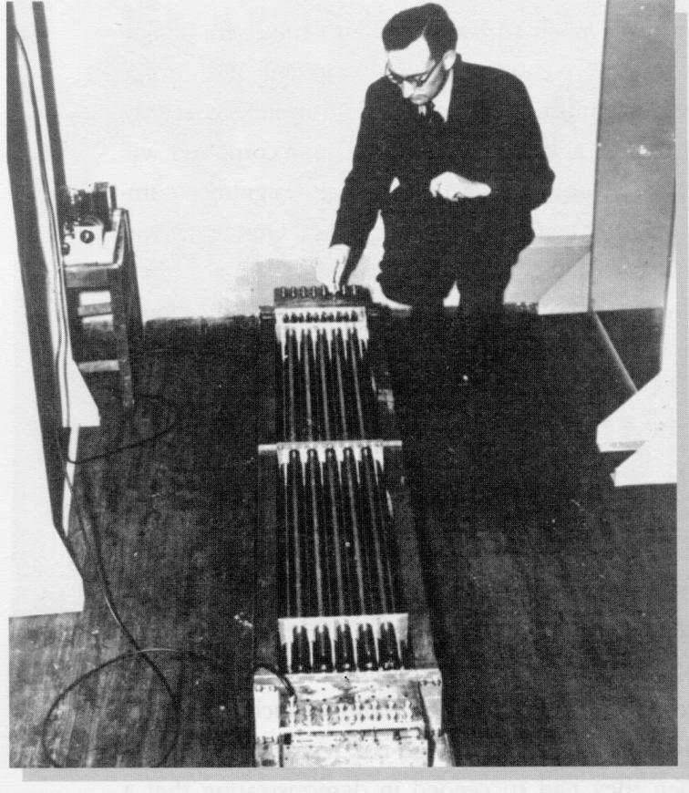
Historical Memory
Before Core Memory Technology:
There was
Mercury Delay Lines!
1949 - EDSAC (Electronic Delay Storage Automatic Computer)
Shift register via acoustic wave in a tube of mercury
(5 feet = 1000 bits)
Notes:
Let’s take a walk down memory lane… get it ☺

Slide 3
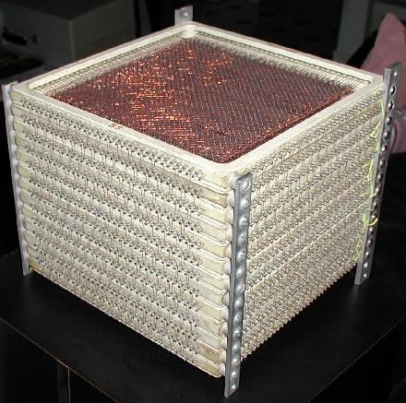
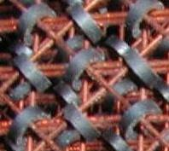
Historical Memory
Where did “Core Memory” come from?
“Out-of-Core”, “In-Core”, “Core Dump”?
“Core memory” (ca. 1955-75)
Non-volatile, magnetic
radiation resistant
This stack is approx. 8 X 8 X 8 inch and consists of 13 x 4096 bits

Slide 4
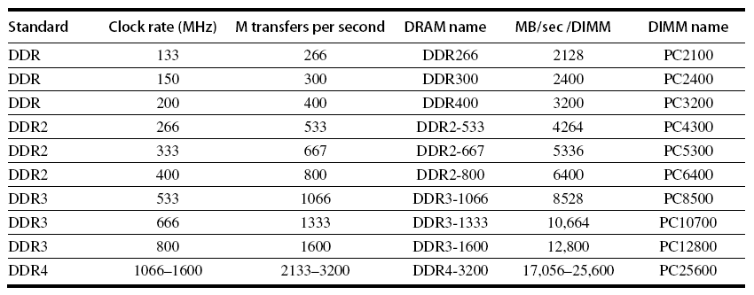
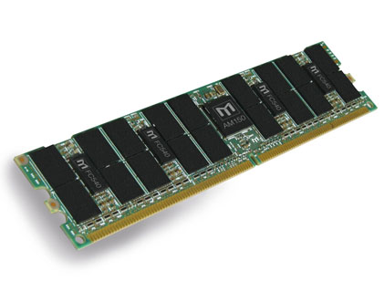
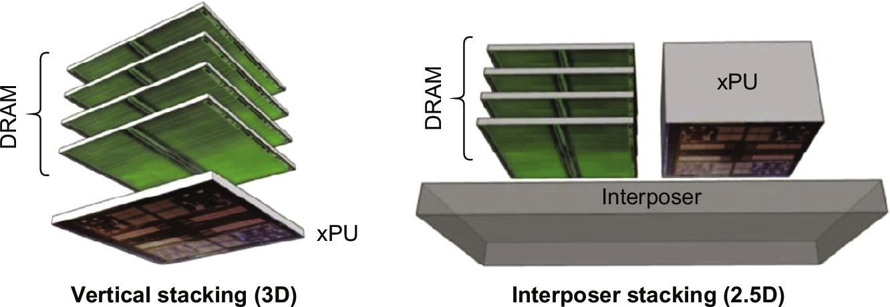
Modern Memory (DIMMS)
?

Slide 5
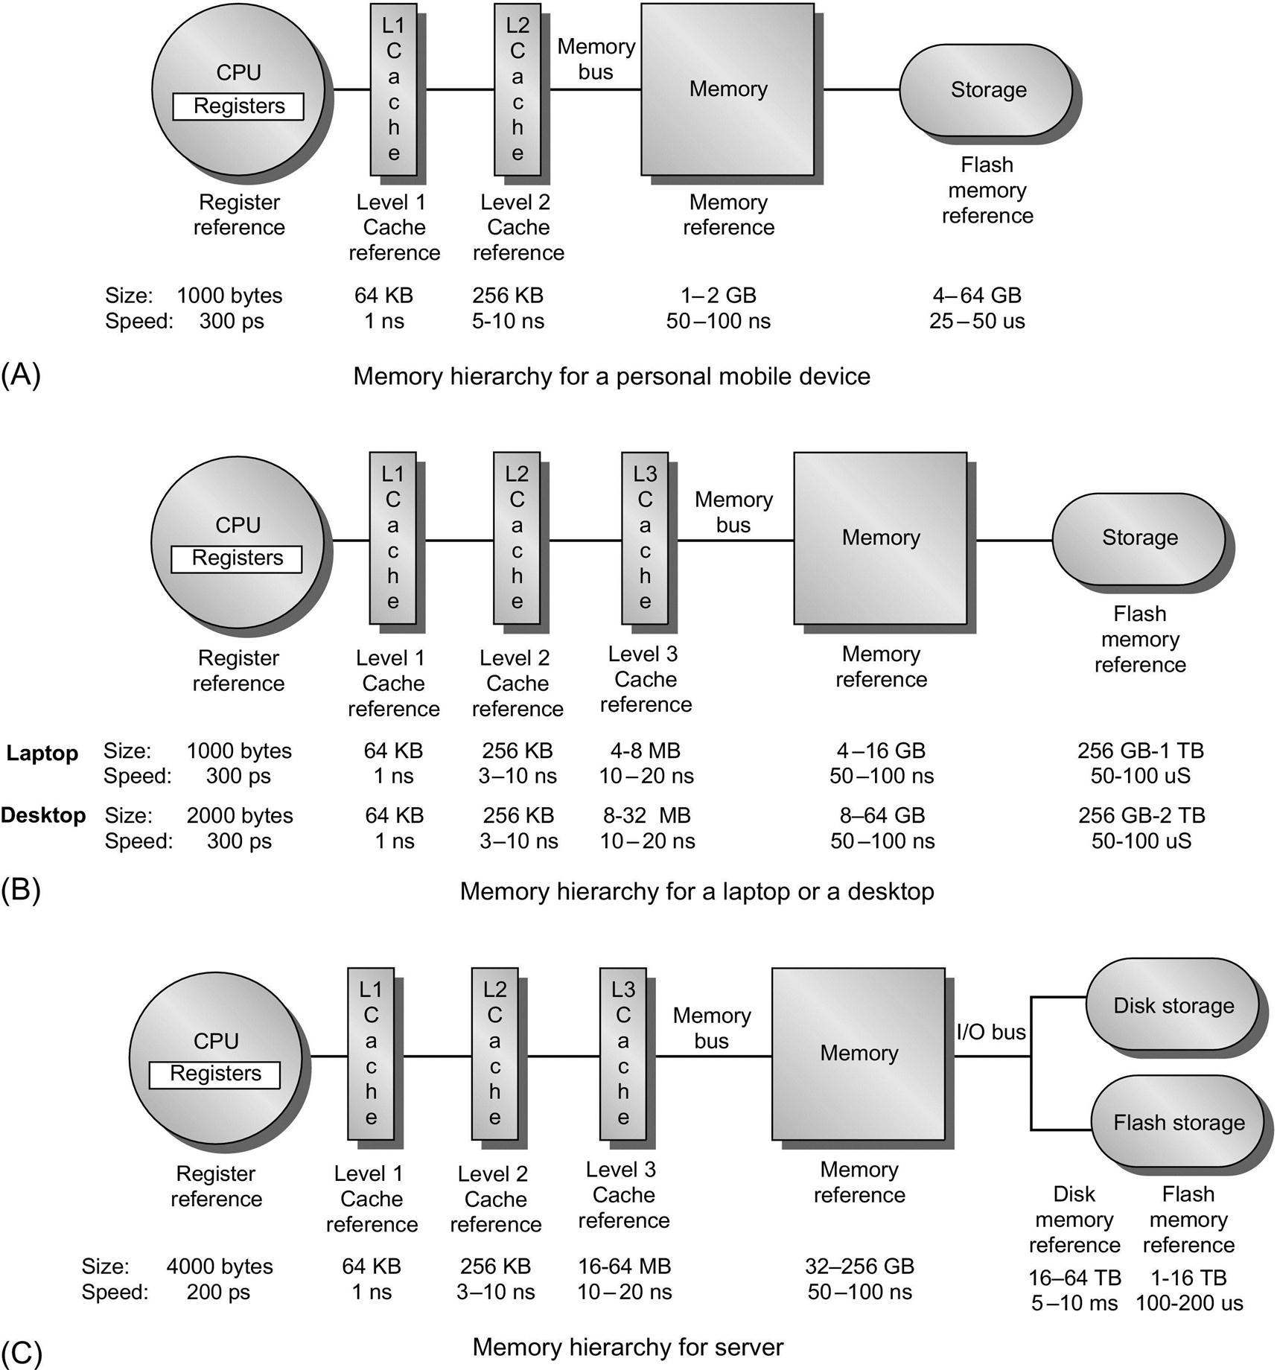
Memory Hierarchy
Memory Hierarchy
(Fig 2.1)
Notes:
Pick a student to explain the differences, and elaborate on why they are different

Slide 6
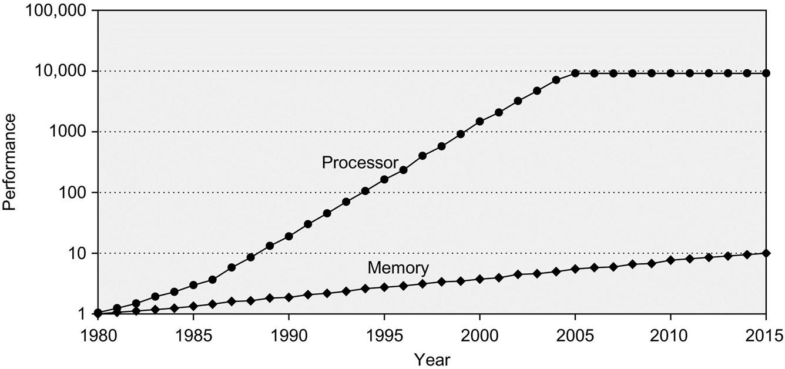
Introduction
Programmers want unlimited memory (with low latency)
Obstacles:
Large memory inherently slow
Fast memory costs more $/bit than slower memory
Processor-DRAM Memory Gap (latency)
Notes:
Concepts in this section are highly interrelated, dependencies in many dimensions, so difficult to absorb in a linear fashion. Recommend reading, then re-reading slides and book sections so that on the second pass, you have familiarity with principles introduced later in the book/slides.
Patience and iteration will pay off in this section.

Slide 7
Memory Hierarchy Design
Example: Intel Core i7
Four cores and 3.2 GHz clock
12.8 billion instruction references (128-bit ) = 1,638.4 Gbps
May generate two references per core per clock
25.6 billion 64-bit data references/second = 1,638.4 Gbps
Max bandwidth demand = 3,276.8 Gbps!
DRAM bandwidth is only 6 8.9% of this (25 34.1 GB/s)
Requires:
Multi-port, pipelined caches
Two levels of cache per core
Shared third-level cache on chip
High-end microprocessors have >10 MB on-chip cache
Consumes large amount of area and power budget
How bad could this be?
Notes:
Consider current multi-core processors, and note that aggregate peak bandwidth grows with # cores….
Wow. Huge demand from processors for memory! Needs elaborate caching scheme to keep up.
What are some issues with having L1, L2 in the core, with L3 shared between cores on the
same chip?

Slide 8
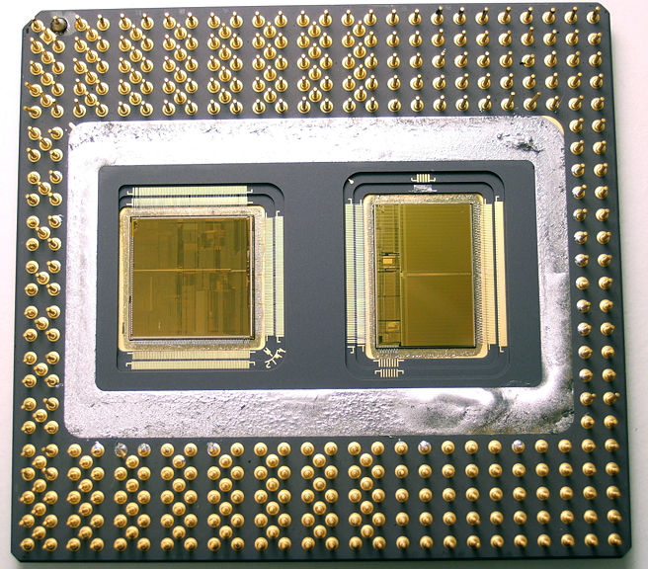
Cache is expensive
Caches have no inherent value
only try to close performance gap
Processor % Area %Transistors
(cost) (power)
(As % of Processor Area) (As % of Processor Power)
Alpha 21164 37% 77%
StrongArm SA110 61% 94%
Pentium Pro 64% 88%
2 dies per package: Proc/I$/D$ + L2$
How do we justify the cost?
Notes:
1/3 to 2/3s of area of processor
386 had 0; successor PPro has second die!
Tangent: why have two die? (hint, defect rates and yield)

Slide 9
Memory Hierarchy Solution
Programmers want unlimited memory (with low latency)
Obstacles:
Large memory inherently slow
Fast memory costs more $/bit than slower memory
Solution: Organize memory system into a hierarchy
Entire addressable memory space available in largest memory
Incrementally smaller and faster memories,
each containing a subset of the memory below it,
proceed in steps up toward the processor
Temporal and spatial locality ensures high probability references can be found in smaller memories
Allusion of a large, fast memory presented to the processor
L1
L2
L3
RAM
Disk
Notes:
Concepts in this section are highly interrelated, dependencies in many dimensions, so difficult to absorb in a linear fashion. Recommend reading, then re-reading slides and book sections so that on the second pass, you have familiarity with principles introduced later in the book/slides.
Patience and iteration will pay off in this section.

Slide 10
The Principle of Locality
The Principle of Locality:
Programs access a relatively small portion of the address space at any instant of time.
Two Different Types of Locality:
Temporal Locality (Locality in Time): If an item is referenced, it will tend to be referenced again soon (e.g., loops, reuse)
Spatial Locality (Locality in Space): If an item is referenced, items whose addresses are close by tend to be referenced soon (e.g., straightline code, array access)
Types of Caches
Instruction
Data
Unified (Instruction and Data)
HW relies on locality for speed
Notes:
The principle of locality states that programs access a relatively small portion of the address space at any instant of time.
This is kind of like in real life, we all have a lot of friends. But at any given time most of us can only keep in touch with a small group of them.
There are two different types of locality: Temporal and Spatial. Temporal locality is the locality in time which says if an item is referenced, it will tend to be referenced again soon.
This is like saying if you just talk to one of your friends, it is likely that you will talk to him or her again soon.
This makes sense. For example, if you just have lunch with a friend, you may say, let’s go to the ball game this Sunday. So you will talk to him again soon.
Spatial locality is the locality in space. It says if an item is referenced, items whose addresses are close by tend to be referenced soon.
Once again, using our analogy. We can usually divide our friends into groups. Like friends from high school, friends from work, friends from home.
Let’s say you just talk to one of your friends from high school and she may say something like: “So did you hear so and so just won the lottery.”
You probably will say NO, I better give him a call and find out more.
So this is an example of spatial locality. You just talked to a friend from your high school days. As a result, you end up talking to another high school friend. Or at least in this case, you hope he still remember you are his friend.
+3 = 10 min. (X:50)

Slide 11
Memory Hierarchy Basics
A “miss” occurs when a word is not found in the cache
Then what?
Fetch word from lower level in hierarchy (and higher latency)
Lower level may be another cache or the main memory
Also fetch some neighbors (other words in the block)
Takes advantage of spatial locality
Place block into cache
Where? What will you eject?
Need to understand/justify cache performance

Slide 12
Memory Hierarchy: Terminology
Hit: data appears in some block in the upper level (example: Block X)
Hit Rate: the fraction of memory accesses found in the upper level
Hit Time: Time to access upper level = access time + time to determine hit/miss
Miss: data must be retrieved from a block in the lower level (Block Y)
Miss Rate = 1 - (Hit Rate)
Miss Penalty: Time to replace a block in the upper level +
Time to deliver the block to the processor
Average memory-access time (AMAT) = Hit time + Miss rate x Miss penalty (ns or clocks)
Lower Level
Memory
To Processor
Upper Level
Memory
Blk X
From Processor
Blk Y
Notes:
We’re all about quantifying, so let’s build up some tools:
A HIT is when the data the processor wants to access is found in the upper level (Blk X).
The fraction of the memory access that are HIT is defined as HIT rate.
HIT Time is the time to access the Upper Level where the data is found (X). It consists of:
(a) Time to access this level.
(b) AND the time to determine if this is a Hit or Miss.
If the data the processor wants cannot be found in the Upper level. Then we have a miss and we need to retrieve the data (Blk Y) from the lower level.
By definition (definition of Hit: Fraction), the miss rate is just 1 minus the hit rate.
This miss penalty also consists of two parts:
(a) The time it takes to replace a block (Blk Y to BlkX) in the upper level.
(b) And then the time it takes to deliver this new block to the processor.
!!! It is very important that your Hit Time to be much much smaller than your miss penalty. Otherwise, there will be no reason to build a memory hierarchy.
+2 = 14 min. (X:54)

Slide 13
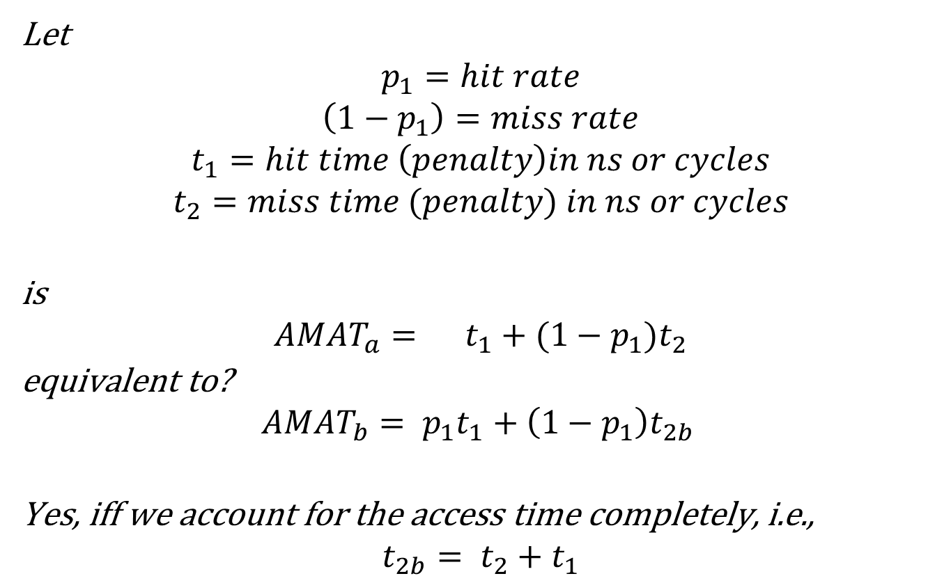
Ambiguity in AMAT formulae
Let
$$p_{1}=hit rate$$
$$\left(1−p_{1}\right)=miss rate$$
$$t_{1}=hit time \left(penalty\right)in ns or cycles$$
$$t_{2}=miss time (penalty) in ns or cycles$$
is
$${AMAT}_{a}= t_{1}+(1−p_{1})t_{2}$$
equivalent to?
$${AMAT}_{b}= {p_{1}t}_{1}+\left(1−p_{1}\right)t_{2b }$$
Yes, iff we account for the access time completely, i.e.,
$$t_{2b}= t_{2}+t_{1}$$

Slide 14
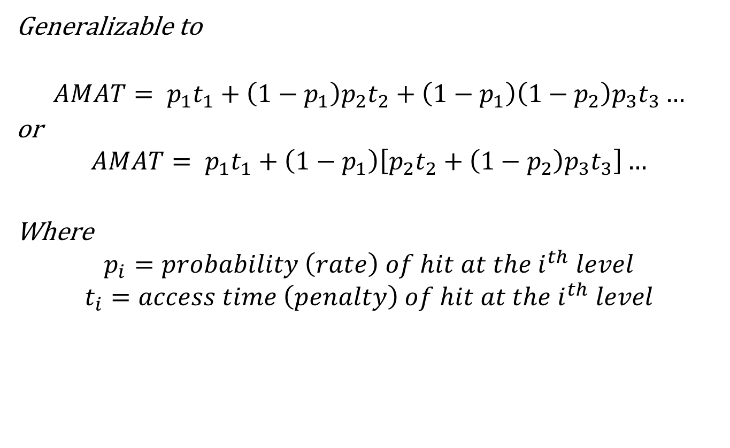
Ambiguity in AMAT formulae
Generalizable to
$$AMAT= {p_{1}t}_{1}+\left(1−p_{1}\right){p_{2}t}_{2}+\left(1−p_{1}\right)\left(1−p_{2}\right)p_{3}t_{3}…$$
or
$$AMAT= {p_{1}t}_{1}+\left(1−p_{1}\right)\left[{p_{2}t}_{2}+\left(1−p_{2}\right)p_{3}t_{3}\right]…$$
Where
$$p_{i}=probability \left(rate\right) of hit at the i^{th} level$$
$$t_{i}=access time \left(penalty\right) of hit at the i^{th} level$$

Slide 15
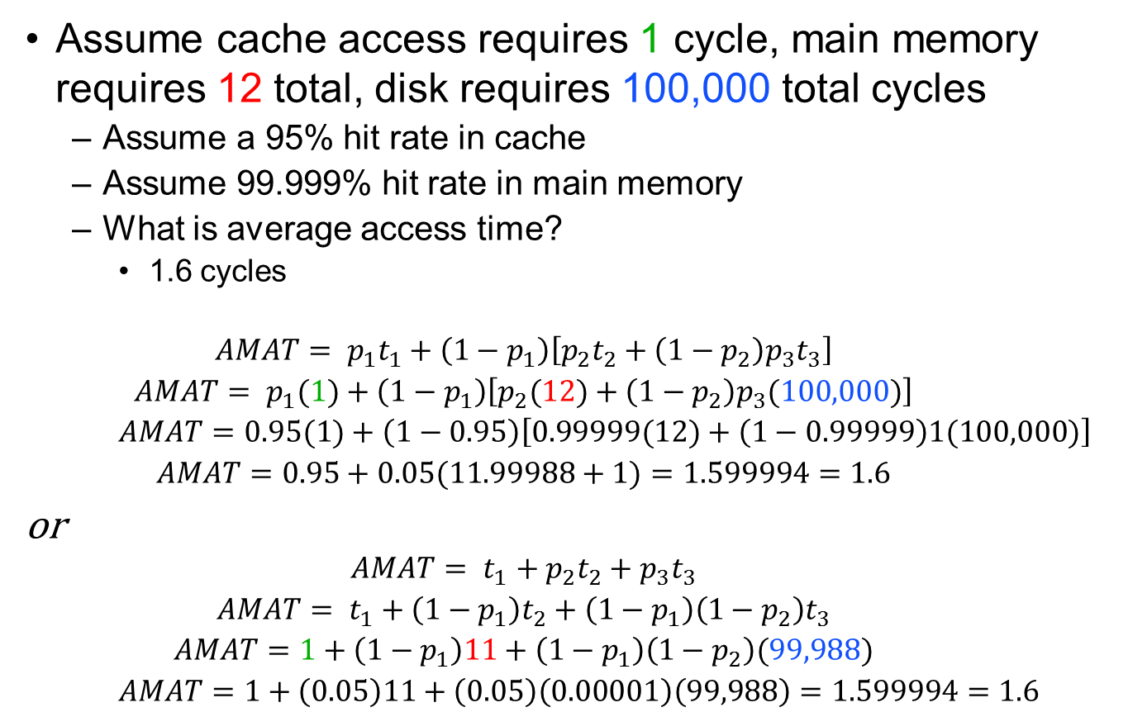
AMAT example
Assume cache access requires 1 cycle, main memory requires 12 total, disk requires 100,000 total cycles
Assume a 95% hit rate in cache
Assume 99.999% hit rate in main memory
What is average access time?
1.6 cycles
$$AMAT= {p_{1}t}_{1}+\left(1−p_{1}\right)\left[{p_{2}t}_{2}+\left(1−p_{2}\right)p_{3}t_{3}\right]$$
$$AMAT= p_{1}(1)+\left(1−p_{1}\right)\left[p_{2}(12)+\left(1−p_{2}\right)p_{3}(100,000)\right]$$
$$AMAT=0.95(1)+\left(1−0.95\right)\left[0.99999(12)+\left(1−0.99999\right)1(100,000)\right]$$
$$AMAT=0.95+0.05(11.99988+1)=1.599994=1.6$$
or
$$AMAT= t_{1}+{p_{2}t}_{2}+p_{3}t_{3}$$
$$AMAT= t_{1}+\left(1−p_{1}\right)t_{2}+\left(1−p_{1}\right)\left(1−p_{2}\right)t_{3}$$
$$AMAT=1+\left(1−p_{1}\right)11+\left(1−p_{1}\right)\left(1−p_{2}\right)(99,988)$$
$$AMAT=1+\left(0.05\right)11+\left(0.05\right)\left(0.00001\right)\left(99,988\right)=1.599994=1.6$$

Slide 16
4 Questions for Memory Hierarchy
Q1: Where can a block be placed in the upper level? (Block placement)
Q2: How is a block found if it is in the upper level? (Block identification)
Q3: Which block should be replaced on a miss? (Block replacement)
Q4: What happens on a write? (Write strategy)

Slide 17
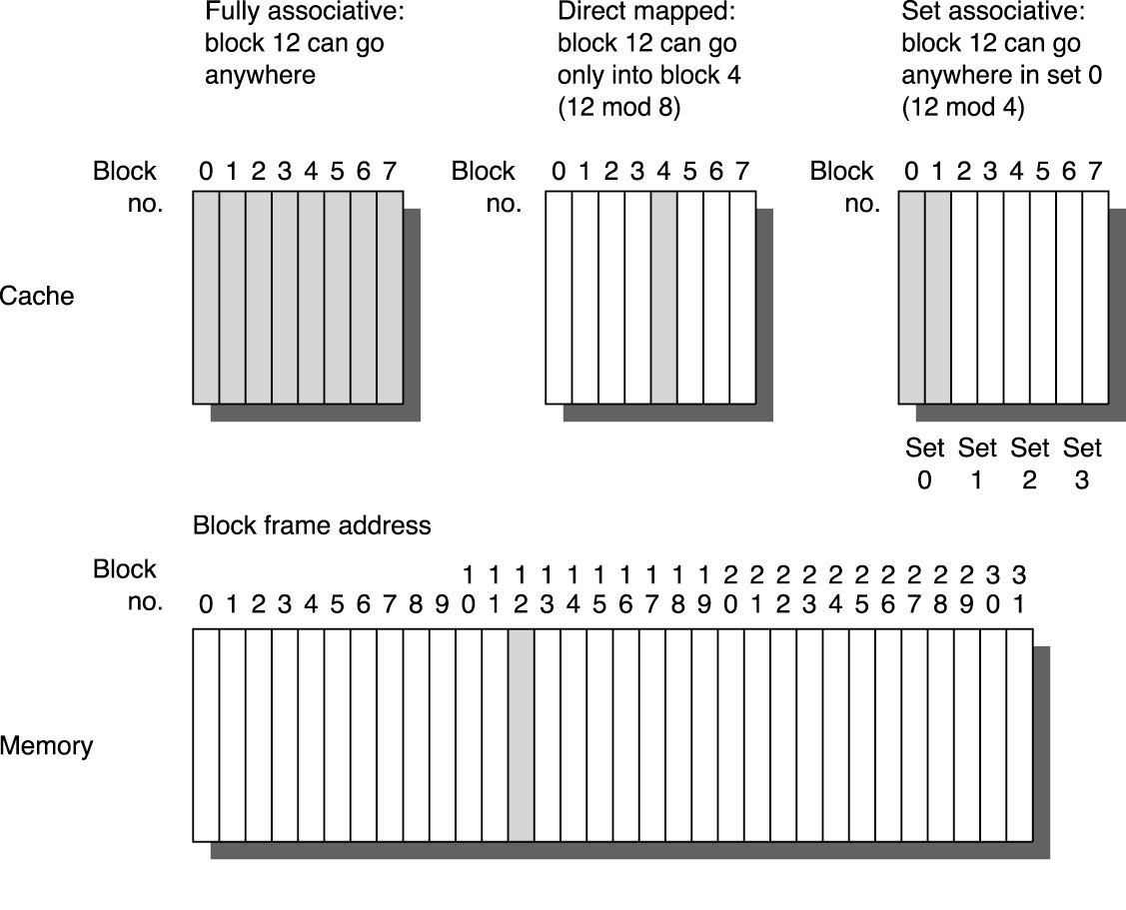
Q1: Where can a block be placed?
Example: Block number 12 placed in a cache of size 8 blocks:
Fully associative,
Direct mapped
2-way set associative
Set Associative Mapping =
Block Number MOD Number of Sets

Slide 18
Simplest Cache: Direct Mapped
Memory
Address
Memory
0
Cache
Index
4 Byte Direct
Mapped Cache
1
2
0
3
1
4
2
5
3
6
7
8
Location 0 can be occupied by data from:
Memory location 0, 4, 8, ... etc.
In this case: any memory location whose 2 LSBs of the address are 0s
Which one should we place in the cache?
How can we tell which one is in the cache?
9
A
B
C
D
E
F
Notes:
Let’s look at the simplest cache one can build. A direct mapped cache that only has 4 bytes.
In this direct mapped cache with only 4 bytes, location 0 of the cache can be occupied by data form memory location 0, 4, 8, C, ... and so on.
While location 1 of the cache can be occupied by data from memory location 1, 5, 9, ... etc.
So in general, the cache location where a memory location can map to is uniquely determined by the 2 least significant bits of the address (Cache Index).
For example here, any memory location whose two least significant bits of the address are 0s can go to cache location zero.
With so many memory locations to chose from, which one should we place in the cache?
Of course, the one we have read or write most recently because by the principle of temporal locality, the one we just touch is most likely to be the one we will need again soon.
Of all the possible memory locations that can be placed in cache Location 0, how can we tell which one is in the cache?
+2 = 22 min. (Y:02)

Slide 19
Q2: How is a block found if it is in the upper level?
Tag on each block
No need to check index (redundant) or block/byte offset (entire block is there or not)
saves hardware and power since don’t need to
Increasing associatively shrinks index, expands tag for a given cache size
Implementing a high degree of associatively is not worthwhile
Cost in comparators continues to grow
yet miss rate improvements are small
Block Address
Block
Offset
Tag
Index

Slide 20
1 KB Direct Mapped Cache, 32B blocks
Need to calculate:
Tag bits
Index bits
Block offset bits (byte select)
31
9
4
0
Cache Tag
Example: 0x50
Cache Index
Byte Select
Ex: 0x01
Ex: 0x00
Stored as part
of the cache “state”
Valid Bit
Cache Tag
Cache Data
Byte 31
:
Byte 1
Byte 0
0
0x50
Byte 63
:
Byte 33
Byte 32
1
2
3
:
:
:
Byte 1023
:
Byte 992
31
Notes:
To address every byte in line need 5 bits (offset)
There are 32 lines so need 5 index bits
Rest are tag (32 - (5+5)) =22

Slide 21
4 KB Direct Mapped Cache
Diagram of a 4K cache (note DATA only)
Block size (amount of data in line) is 4 bytes
A
d
d
r
e
s
s
(
s
h
o
w
i
n
g
b
i
t
p
o
s
i
t
i
o
n
s
)
3
1
3
0
1
3
1
2
1
1
2
1
0
o
B
y
t
e
f
f
s
e
t
H
i
t
T
a
g
2
0
1
0
D
a
t
a
I
n
d
e
x
I
n
d
e
x
V
a
l
i
d
T
a
g
D
a
t
a
0
1
2
1
0
2
1
1
0
2
2
1
0
2
3
2
0
3
2
In reality we have 6.625 KB in the cache. WHY?
Notes:
What is the total number of bits in the cache?
Each line has 32 + 20 + 1 bit = 53 bits
Total space required: 53 bits * 1024 lines= 54,372 bits = 6784 bytes = 6.625 KB

Slide 22
Types of Cache Misses
The 3-C’s
Compulsory—The first access to a block is not in the cache, so the block must be brought into the cache. Also called cold start misses or first reference misses. (Misses in an Infinite Cache)
Capacity—If the cache cannot contain all the blocks needed during execution of a program, capacity misses will occur due to blocks being discarded and later retrieved. (Misses in Fully Associative Cache of Size X)
Conflict—If block-placement strategy is set associative or direct mapped, conflict misses (in addition to compulsory & capacity misses) will occur because a block may be discarded and later retrieved if too many blocks map to its set. Also called collision misses or interference misses. (Misses in N-way Associative Cache of Size X)
Notes:
When we add in multi-threading, or multi-core processors, we introduce a new C, Coherency.

Slide 23
Cache Associativity
Fully associative caches
Line can go anywhere
Direct-mapped caches
where data could only go in one place
Which of these approaches is likely to have a better hit rate?
Fully associative only kicks out other data if cache totally full
Direct-mapped could have conflict with only 1 piece of info in cache
So, why don’t we build all caches fully associative?
More hardware
Slower access

Slide 24
Cache
But perhaps there is a compromise solution, making the cache partly associative
Doesn’t slow down access
Provides a better hit rate
This is concept behind set-associative caches
For a 2-way set-associative cache:
Each line in the cache has two sets of tags, valid bits, and data
The tag of both sets must be compared to determine if data is in cache
Select which data is sent to processor

Slide 25
Two-way Set Associative Cache
N-way set associative: N entries for each Cache Index
N direct mapped caches operates in parallel (N typically 2 to 16)
Example: Two-way set associative cache
Cache Index selects a “set” from the cache
The two tags in the set are compared in parallel
Data is selected based on the tag result
Cache Index
Valid
Cache Tag
Cache Data
Cache Data
Cache Tag
Valid
Cache Block 0
Cache Block 0
:
:
:
:
:
:
Addr Tag
Addr Tag
Compare
Sel1
1
Mux
0
Sel0
Compare
OR
Cache Block
Hit
Notes:
This is called a 2-way set associative cache because there are two cache entries for each cache index. Essentially, you have two direct mapped cache works in parallel.
This is how it works: the cache index selects a set from the cache. The two tags in the set are compared in parallel with the upper bits of the memory address.
If neither tag matches the incoming address tag, we have a cache miss.
Otherwise, we have a cache hit and we will select the data on the side where the tag matches occur.
This is simple enough. What is its disadvantages?
+1 = 36 min. (Y:16)

Slide 26
Four-way Set Associative Cache
Notes:
How big
Data: 1 word = 4 bytes
4 bytes * 4 elements / cache index line * 256 lines = 4 KB

Slide 27
What is a set versus a way?
Way
I
n
d
e
x
V
T
a
g
D
a
t
a
V
T
a
g
D
a
t
a
V
T
a
g
D
a
t
a
V
T
a
g
D
a
t
a
0
1
2
Set
2
5
3
2
5
4
2
5
5

Slide 28
Set, Ways, Blocks ….
A.
V
T
a
g
D
a
t
a
V
T
a
g
D
a
t
a
V
T
a
g
D
a
t
a
V
T
a
g
D
a
t
I
a
n
d
e
x
0
B.
#Sets _______
#Ways _______
#Blocks _______
I
n
d
e
x
V
T
a
g
D
a
t
a
V
T
a
g
D
a
t
a
0
1
2
2
5
3
#Sets _______
#Ways _______
#Blocks _______
2
5
4
2
5
5
C.
#Sets _______
#Ways _______
#Blocks _______
I
n
d
e
x
V
T
a
g
D
a
t
a
0
1
2
2
5
3
#Sets X #Ways = #Blocks
2
5
4
2
5
5

Slide 29
Q3: Which block should be replaced on a miss?
Easy for Direct Mapped – no choice
Set Associative or Fully Associative
Cache controller decides
Random
LRU (Least Recently Used)
FIFO (oldest gets kicked out)
Miss Rate
Associativity
2-way 4-way 8-way
Size LRU Random LRU Random LRU Random
16 KB 5.2% 5.7% 4.7% 5.3% 4.4% 5.0%
64 KB 1.9% 2.0% 1.5% 1.7% 1.4% 1.5%
256 KB 1.15% 1.17% 1.13% 1.13% 1.12% 1.12%

Slide 30
Q4: What happens on a write?
Write through—The information is written to both the block in the cache and to the block in the lower-level memory.
Write back—The information is written only to the block in the cache. The modified cache block is written to main memory only when it is replaced.
Pros and Cons of each?
WT
easier to implement and main memory always has latest version
read misses do not result in writes
WB
no repeated writes to same location in secondary memory
saves power since access to memory hierarchy and buses has less traffic

Slide 31
What about Write Misses
Write allocate – read the block into cache before writing
Write miss just like a read miss
May need block again
No-write allocate
Block modified only in lower memory
No cache update
Not common

Slide 32
Write Buffer for Write Through
Cache
Processor
DRAM
Write Buffer
A Write Buffer is needed between the processor and memory
Processor: writes data into the cache and the write buffer
Memory controller: write contents of the buffer to memory
Write buffer is just a FIFO:
Typical number of entries: 4
Works fine if: Store frequency (w.r.t. time) << 1 / DRAM write cycle
Memory system designer’s nightmare:
Store frequency (w.r.t. time) -> 1 / DRAM write cycle
Write buffer saturation
Notes:
You are right, memory is too slow. We really didn't write to the memory directly. We are writing to a write buffer.
Once the data is written into the write buffer and assuming a cache hit, the CPU is done with the write. The memory controller will then move the write buffer’s contents to the real memory behind the scene.
The write buffer works as long as the frequency of store is not too high. Notice here, I am referring to the frequency with respect to time, not with respect to number of instructions.
Remember the DRAM cycle time we talked about last time. It sets the upper limit on how frequent you can write to the main memory.
If the store are too close together or the CPU time is so much faster than the DRAM cycle time, you can end up overflowing the write buffer and the CPU must stop and wait.
+2 = 60 min. (Y:40)

Slide 33
More Realistic View on CPU Time
How do we improve cache/memory performance?
Reduce:
Hit time
Miss rate
Miss penalty

Slide 34
6 Basic Cache Optimizations

Slide 35
1. Larger Block Size
Pros
Increases hit rate
Takes advantage of spatial locality (compulsory misses)
Cons
Can increase miss penalty
Increases conflict and capacity misses is cache too small
Conflict increases
Word more likely
to be in block
Cache size
2. Reduce misses with larger cache
Notes:
Increasing the block size attempts to take advantage of spatial locality in order to reduce compulsory misses. One problem is that larger blocks can increase conflict and even capacity misses if cache is small. Another is that larger blocks can increase miss penalty; even though miss rate may decrease one must ensure that AMAT does not increase.
Selection of block size depends on both latency and bandwidth of lower-level memory: high latency, i.e., slow access time, implies miss penalty is already high and so fetching larger blocks will increase penalty by small factor if bandwidth is also high conversely, low latency and low bandwidth encourage smaller blocks, which may reduce conflict misses

Slide 36
2. Larger Cache
Pros
Reduce miss rate
Less capacity misses (and maybe conflict misses)
Cons
Increase hit time
Increase in power consumption

Slide 37
3. Higher Associativity
Pros
Reduce miss rate
2:1 Cache Rule:
Miss Rate Direct Mapped cache size N ≈ Miss Rate 2-way cache size N/2 (for cache sizes under 128K)
Cons
increased hit time and slower clock rate
Cache Size Associativity
(KB) 1-way 2-way 4-way 8-way
4 3.44 3.25 3.22 3.38
8 2.69 2.58 2.55 2.62
16 2.23 2.40 2.46 2.53
32 2.06 2.30 2.37 2.45
64 1.92 2.14 2.18 2.25
128 1.52 1.84 1.92 2.00
256 1.32 1.66 1.74 1.82
512 1.20 1.55 1.59 1.66
(Red means A.M.A.T. (in cc’s) not improved by more associativity)
Notes:
TTL: Transistor–transistor logic
ECL: emitter-coupled logic
CMOS: Complementary metal–oxide–semiconductor

Slide 38
4. Multi-level Caches: reduce AMAT
L2 Equations
AMAT = Hit Time_{L1} + Miss Rate_{L1} x Miss Penalty_{L1} Miss Penalty_{L1} = Hit Time_{L2} + Miss Rate_{L2} x Miss Penalty_{L2}
AMAT = Hit Time_{L1} + Miss Rate_{L1} x (Hit Time_{L2} + Miss Rate_{L2} x Miss Penalty_{L2})
Definitions:
Local miss rate— misses in this cache divided by the total number of memory accesses to this cache (Miss rate_{L2})
Global miss rate—misses in this cache divided by the total number of memory accesses generated by the CPU (Miss Rate_{L1} x Miss Rate_{L2})
Global Miss Rate measures effectiveness of entire cache scheme (L1 L2 … Ln)
Global Miss Rate is what matters
If in 1000 memory references, 40 result in misses by first-level cache, of which 20 also miss in second-level cache
then Miss rate_{L1} = 4% and Miss rate_{L2} = 50%, so L2's global miss rate is 2%
Notes:
With two levels of cache between CPU and memory, first-level cache can be small enough to match clock cycle time of fast CPU and second-level cache can be made large enough to capture many misses (so reducing effective miss penalty) of first-level cache. Assuming write-back first-level cache, miss penaltyL1 = AMATL2
N.B. Miss rateL2 is local and must be multiplied by Miss rateL1 to obtain global miss rate, i.e., fraction of memory accesses by CPU that go all the way to memory e.g., if in 1000 memory references, 40 result in misses by first-level cache, of which 20 also miss in second-level cache, then Miss rateL1 = 4% and Miss rateL2 = 50%, so L2's global miss rate is 2%
With fewer hits and more misses, we should concentrate on decreasing the local miss rate of second-level cache, rather than on making hits fast.
Indeed, we have more freedom in applying miss rate reduction techniques because, unlike single cache, speed of second-level cache does not limit clock rate of CPU
Second-level caches should be large enough to eliminate capacity misses, have larger blocks to reduce compulsory misses (e.g., 64-byte, 128-bytes or even 256-byte blocks) and use higher associativity or pseudo-associativity to reduce conflict misses

Slide 39
4. Multi-level Caches: reduce AMAT
L2 cache speed is not tied to CPU clock rate!
L1 clock rate affects CPU clock rate
L2 speed only affects L1 miss penalty
In L2 cache want fewer misses since number of requests small compared to L1 cache
L2 caches should be
much bigger than L1 caches
large enough to eliminate capacity misses
have larger blocks to reduce compulsory misses (e.g., 64-byte, 128-bytes or even 256-byte blocks)
use higher associativity or to reduce conflict misses

Slide 40
5. Reducing Miss Penalty: Read Priority over Write on Miss
Why would you like reads to have priority over writes?
Write through cache
If write buffers used, reads may cause a RAW conflict when cache misses
If wait for write buffer to empty, read miss penalty will grow
Solution: Check write buffer contents before read
Take data from the write buffer if possible
Otherwise, let the memory access continue
Write back cache
Read miss results in replacing a dirty block
Normal: Write dirty block to memory, and then do the read
However, that’s too costly: Why?
So move dirty block to a write buffer, then read, and then write back from buffer
CPU stall less since restarts as soon as do read
Notes:
With write-through cache, most important improvement is write buffer of proper size (i.e., large enough that it rarely fills, so keeping CPU write stall time low). The complication to memory access is that write buffer contains most up-to-date information.
It may be preferable for a read miss to check buffer's contents before fetching (if necessary) from lower-level memory, rather than to wait for buffer to be empty e.g., MIPS M/1000 designers estimated waiting for 4 word buffer to empty would have increased average read miss penalty by 50%.
With write-back cache, a dirty block being replaced as a result of a read miss might first be buffered --- this allows the read to be handled before the dirty block is written to memory, rather than making the read wait for the write to have completed.

Slide 41
6. Avoiding Address Translation in Cache Indexing
Use Virtual Address to reduce hit time
Virtual Memory is a simple concept that provides a mapping between
Virtual program addresses produced by compiler
Program stored on disk memory
Physical addresses of main memory
Physical cache versus virtual cache
Store physical addresses or virtual addresses in cache?
If TLB between processor and cache, then physical
Virtual address from processor
Virtual address from processor
TLB
Virtual
Cache
Physical
Cache
TLB
Memory
Memory

Slide 42
3Cs Absolute Miss Rate (SPEC92)
0.14
Conflict
1-way
0.12
2-way
0.1
4-way
0.08
8-way
Miss Rate per Type
0.06
Capacity (fully associative)
0.04
0.02
0
1
2
4
8
16
32
64
2:1 cache rule
2-way assoc
1-way assoc
w/same miss rate
128
Cache Size (KB)
Compulsory
Compulsory vanishingly small

Slide 43
10 Advanced Cache Optimizations
Five Categories:
Reduce Hit Time
Increase Cache Bandwidth
Reduce Miss Penalty
Reduce Miss Rate
Reducing Miss Rate or Miss penalty via Parallelism

Slide 44
1. Small & Simple 1st L1
Critical timing path:
addressing tag memory, then
comparing tags, then
selecting correct set
Direct-mapped caches can overlap tag compare and transmission of data
Lower associativity reduces power because fewer cache lines are accessed

Slide 45
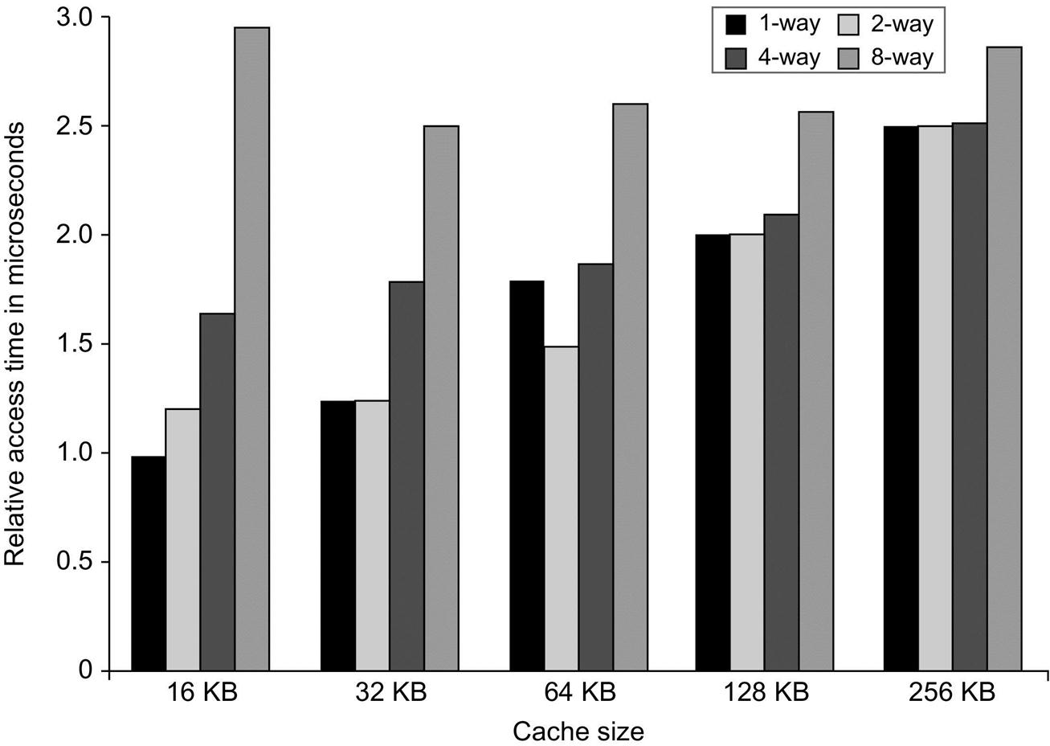
L1 Size and Associativity
Access time vs. size and associativity
Notes:
Note that a 3.2GHz clock has a period of 312.7ps
Some newer designs are allowing 2 cc’s for L1 access allowing higher associativity
Pentium 4 has an 8KB L1 cache

Slide 46
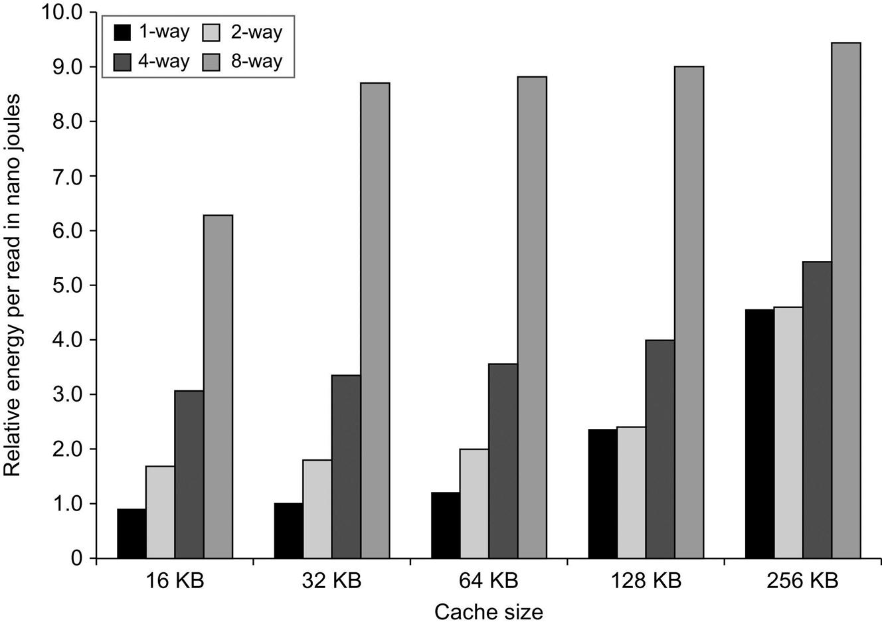
L1 Size and Associativity
Energy per read vs. size and associativity

Slide 47
2. Way Prediction
To improve hit time, predict the “way” to pre-set mux & only check that tag
Prediction bits added to cache)
Prediction accuracy
> 90% for two-way
> 80% for four-way
I-cache has better accuracy than D-cache
First used on MIPS R10000 in mid-90s
Used on ARM Cortex-A8
Mis-prediction gives longer hit time
A mis-prediction penalty
If wrong, now I have to go back and check others normally
Notes:
Can also start sending data to processor like a direct mapped cache and not use if missed.

Slide 48
3. Pipelined Cache
Pipeline cache access to improve bandwidth
Examples:
Pentium: 1 cycle
Pentium Pro – Pentium III: 2 cycles
Pentium 4 – Core i7: 4 cycles
Makes it easier to increase associativity
Increases branch mis-prediction penalty
Notes:
Can also start sending data to processor like a direct mapped cache and not use if missed.

Slide 49
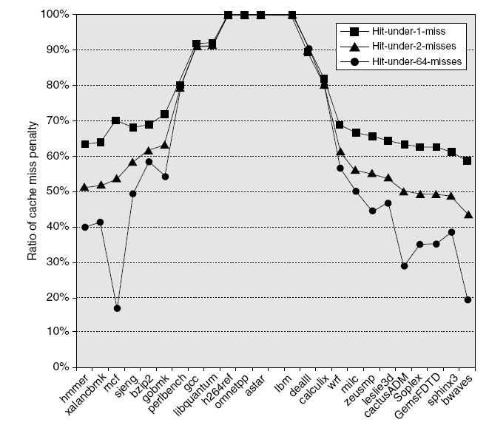
4. Nonblocking Caches
Can be used in “out-of-order” processors
Allow hits before previous misses complete
“Hit under miss”
“Hit under multiple miss”
Increases BW
Reduces the average miss penalty vs. a blocking cache
Significantly increases complexity

Slide 50
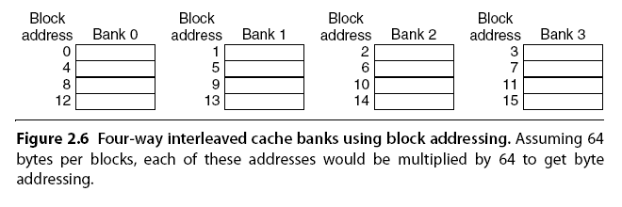
5. Multibanked Caches
Organize cache as independent banks to support simultaneous access
ARM Cortex-A8 supports 1-4 banks for L2
Intel i7 supports 4 banks for L1 and 8 banks for L2
Interleave banks according to block address
Notes:
Similar to idea of multibanked DRAM. Once I find line can read all in line simultaneously

Slide 51
6. Critical Word First and Early Restart
Reduce Miss Penalty
Don’t wait for full block to be loaded before restarting CPU (CPU is impatient) Here are two strategies:
Critical Word First—Request the missed word first from memory and send it to the CPU as soon as it arrives; let the CPU continue execution while filling the rest of the words in the block.
Also called wrapped fetch and requested word first
Early restart—
Fetch words in normal order
As soon as the requested word of the block arrives, send it to the CPU and let the CPU continue execution
Generally useful only in large blocks,
Spatial locality a problem; tend to want next sequential word, so not clear if benefit by these strategies? WHY?
block
Notes:
Cache can take into account that CPU will only need one word of a block cache is fetching from memory by allowing early restart, i.e., as soon as requested word of block arrives send it to CPU and let CPU continue execution. Critical-word-first fetch (also called wrapped fetch) encourages early restart by fetching the requested word of the block first.
Early restart and critical word first are only worthwhile for large blocks and may not help much, if at all, when remainder of block is accessed immediately after.

Slide 52
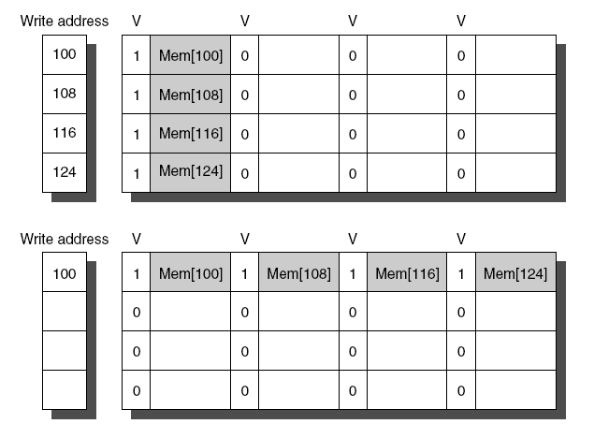
7. Merging Write Buffer
When storing to a block that is already pending in the write buffer, update write buffer
Reduces stalls due to full write buffer
Multi-word writes more efficient
w/o write merge
Write merging

Slide 53
8. Compiler Optimizations
McFarling [1989] reduced cache misses by 75% on 8KB direct-mapped cache, 4 byte blocks in software
Instructions
Reorder procedures in memory so as to reduce conflict misses
Profiling to look at conflicts (using tools they developed)
Data
Merging Arrays: improve spatial locality by single array of compound elements vs. 2 arrays
Loop Fusion: Combine 2 independent loops that have same looping and some variables overlap
Loop Interchange: change nesting of loops to access data in order stored in memory
Blocking: Improve temporal locality by accessing “blocks” of data repeatedly vs. going down whole columns or rows

Slide 54
Merging Arrays Example
/* Before: 2 sequential arrays */
int val[SIZE];
int key[SIZE];
/* After: 1 array of structures */
struct merge {
int val;
int key;
};
struct merge merged_array[SIZE];
Reducing conflicts between val & key; improve spatial locality
val₁..val_{Size}
key₁..key_{Size}
val₁,key₁
val₂,key₂
val…,key…
val_{Size},key_{Size}

Slide 55
Loop Fusion Example
/* Before */
for (i = 0; i < N; i = i+1)
for (j = 0; j < N; j = j+1)
a[i][j] = 1/b[i][j] * c[i][j];
for (i = 0; i < N; i = i+1)
for (j = 0; j < N; j = j+1)
d[i][j] = a[i][j] + c[i][j];
/* After */
for (i = 0; i < N; i = i+1)
for (j = 0; j < N; j = j+1)
{ a[i][j] = 1/b[i][j] * c[i][j];
d[i][j] = a[i][j] + c[i][j];}
2 misses per access to a & c vs. one miss per access; improve spatial locality

Slide 56
Loop Interchange Example
0,0 0,1 0,2 ... 0,98 0,99
1,0 1,1 1,2 ... 1,98 1,99
2,0
.
.
.
4998,0
4999,0 4999,1 ... 4999,99
/* Before */
for (j = 0; j < 100; j = j+1)
for (i = 0; i < 5000; i = i+1)
x[i][j] = 2 * x[i][j];
/* After */
for (i = 0; i < 5000; i = i+1)
for (j = 0; j < 100; j = j+1)
x[i][j] = 2 * x[i][j];
Scan down column 0, then column 1 …
0,0 0,1 0,2 ... 0,98 0,99
1,0 1,1 1,2 ... 1,98 1,99
2,0
.
.
.
4998,0
4999,0 4999,1 ... 4999,99
The “after” provides sequential accesses instead of striding through memory every 100 words → improved spatial locality
(C and C++ access arrays in row-major order – 5000 rows and 100 columns)
Scan across row 0, then row 1 …
Notes:
Row Major order: Array stored in memory row-by-row
Column Major order:

Slide 57
Blocking Example
y
(NxN)
(i row)
z
(NxN)
/* Before */
for (i = 0; i < N; i = i+1)
for (j = 0; j < N; j = j+1)
{r = 0;
for (k = 0; k < N; k = k+1)
{r = r + y[i][k]*z[k][j];};
x[i][j] = r;
};
Two Inner Loops:
Read all NxN elements of z[ ]
Read N elements of 1 row of y[ ] repeatedly
Write N elements of 1 row of x[ ]
Capacity Misses a function of N & Cache Size:
Idea: compute on BxB submatrix that fits in cache
i
k
( j col)
k
j
j
∑
x
(NxN)
∑
…
i

Slide 58
Blocking Example
y
(NxN)
z
(NxN)
(i row) N/B
i
( j col) N/B
/* After */
for (jj = 0; jj < N; jj = jj+B)
for (kk = 0; kk < N; kk = kk+B)
for (i = 0; i < N; i = i+1)
for (j = jj; j <
min(jj+B-1,N); j = j+1)
{r = 0;
for (k = kk; k < min(kk+B-1,N);
k = k+1) {
r = r + y[i][k]*z[k][j];};
x[i][j] = x[i][j] + r;
};
B called Blocking Factor
Number of reads for y and z is 2N³, writes to x is N²
Capacity Misses reduced from 2N³ + N² to 2N³ / B+N²
k
k
j
j
∑
x
(NxN)
∑
…
i

Slide 59
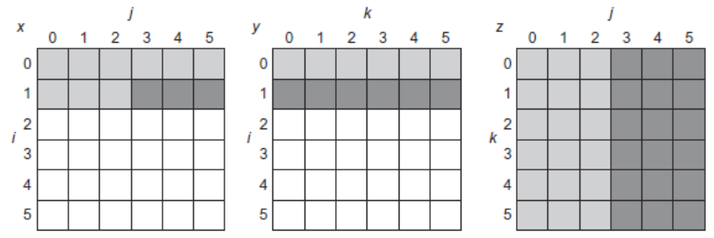
Blocking
for (i = 0; i < N; i = i + 1)
for (j = 0; j < N; j = j + 1)
{
r = 0;
for (k = 0; k < N; k = k + 1)
r = r + y[i][k]*z[k][j];
x[i][j] = r;
};

Slide 60
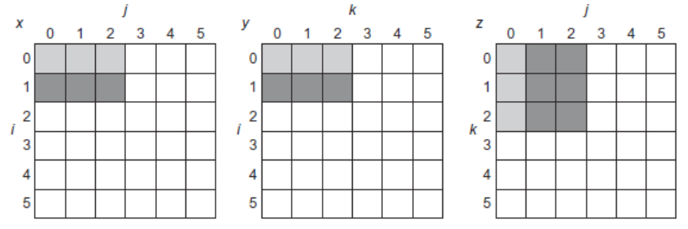
Blocking
for (jj = 0; jj < N; jj = jj + B)
for (kk = 0; kk < N; kk = kk + B)
for (i = 0; i < N; i = i + 1)
for (j = jj; j < min(jj + B,N); j = j + 1)
{
r = 0;
for (k = kk; k < min(kk + B,N); k = k + 1)
r = r + y[i][k]*z[k][j];
x[i][j] = x[i][j] + r;
};

Slide 61
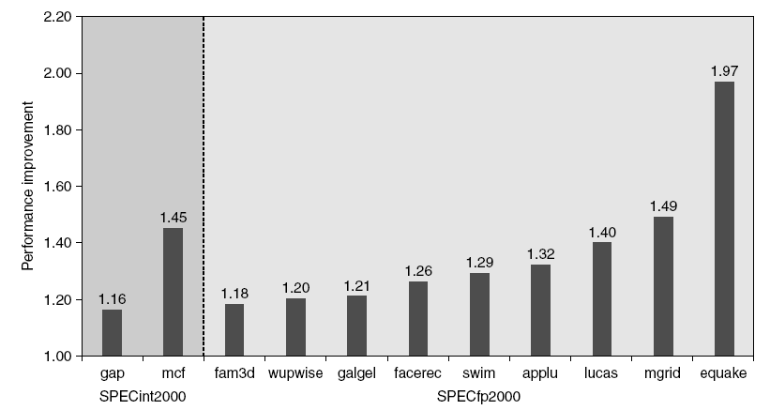
9. Hardware Prefetching
Instruction Prefetching
Fetch 2 blocks on a miss
Extra block placed in “stream buffer”
On miss check stream buffer
Lowers Miss Penalty
Works with data blocks too:
Jouppi [1990]: 1 data stream buffer got 25% misses from 4KB direct mapped cache; 4 streams got 43%
Prefetching relies on having extra memory bandwidth that can be used without penalty
Pentium 4 Pre-fetching
Notes:
Items can be prefetched before they are requested by the processor, either directly into cache or into external buffer. Instruction prefetch into instruction stream buffer is common e.g., Alpha AXP 21064 fetches 2 blocks on miss: requested block for cache and next consecutive block for buffer, which contains at most one 32-byte block
Fetching instruction involves checking cache and buffer --- hit time for buffer perhaps costs extra cycle
If block is found in buffer, next block is prefetched Instruction stream buffer with single place has been found to catch 15% to 25% of misses from 4-KB direct-mapped instruction cache with 16-byte blocks, improving to about 50% with 4 places and to 72% with 16 places --- likewise, data stream buffer with single place has been found to catch 25% of misses from data cache
For data caches. multiple buffers prefetching at different addresses can be effective, e.g., 4 data stream buffers caught 43% of misses e.g., 8 stream buffers that could be used for either instructions or data found to capture 50% to 70% of misses, on processor running scientific programs with separate 64-KB 4-way set associative caches
Prefetching relies on utilizing memory bandwidth that would otherwise be unused --- it can lower performance if it interferes with obtaining blocks that are actually required by processor!

Slide 62
10. Compiler-Controlled Prefetching Data
Compiler can insert instructions to prefetch data before it is needed
Register prefetch: Load data into register
Cache prefetch: Load block into cache
Special prefetching instructions cannot cause faults
a form of speculative execution
Only useful if processor can continue to obtain instructions and data while cache is waiting for prefetched data
such caches are known as nonblocking or lookup-free
Prefetch instructions increase IC, so compiler should concentrate on memory references that are likely to result in cache misses
Issuing Prefetch Instructions takes time
Is cost of prefetch issues < savings in reduced misses?
Higher superscalar reduces difficulty of issue bandwidth
Notes:
Compiler can insert instructions to prefetch data before it is needed register prefetch --- loads value into register
cache prefetch --- loads block into cache
These can be nonfaulting or faulting according to whether or not exceptions (page faults and protection violations) are to be ignored
Normal load instruction can be thought of as faulting register prefetch
Nonfaulting prefetches turn into no-ops should exception arise
Nonfaulting cache prefetch is also called nonbinding prefetch because it is "semantically invisible"
Prefetching makes sense only if processor can continue to obtain instructions and data while cache is waiting for prefetched data --- such caches are known as nonblocking or lookup-free
Since prefetch instructions increase IC, compiler should concentrate on memory references that are likely to result in cache misses

Slide 63
Use HBM to Extend Hierarchy
128 MiB to 1 GiB
Smaller blocks require substantial tag storage
Larger blocks are potentially inefficient
One approach (L-H):
Each SDRAM row is a block index
Each row contains set of tags and 29 data segments
29-set associative
Hit requires a CAS
Another approach (Alloy cache):
Mold tag and data together
Use direct mapped
Both schemes require two DRAM accesses for misses
Two solutions:
Use map to keep track of blocks
Predict likely misses
Advanced Optimizations
Notes:
High Bandwidth Memory

Slide 64
Use HBM to Extend Hierarchy
Another approach (Alloy cache):
Mold tag and data together
Use direct mapped
Both schemes require two DRAM accesses for misses
Two solutions:
Use map to keep track of blocks
Predict likely misses
Advanced Optimizations

Slide 65
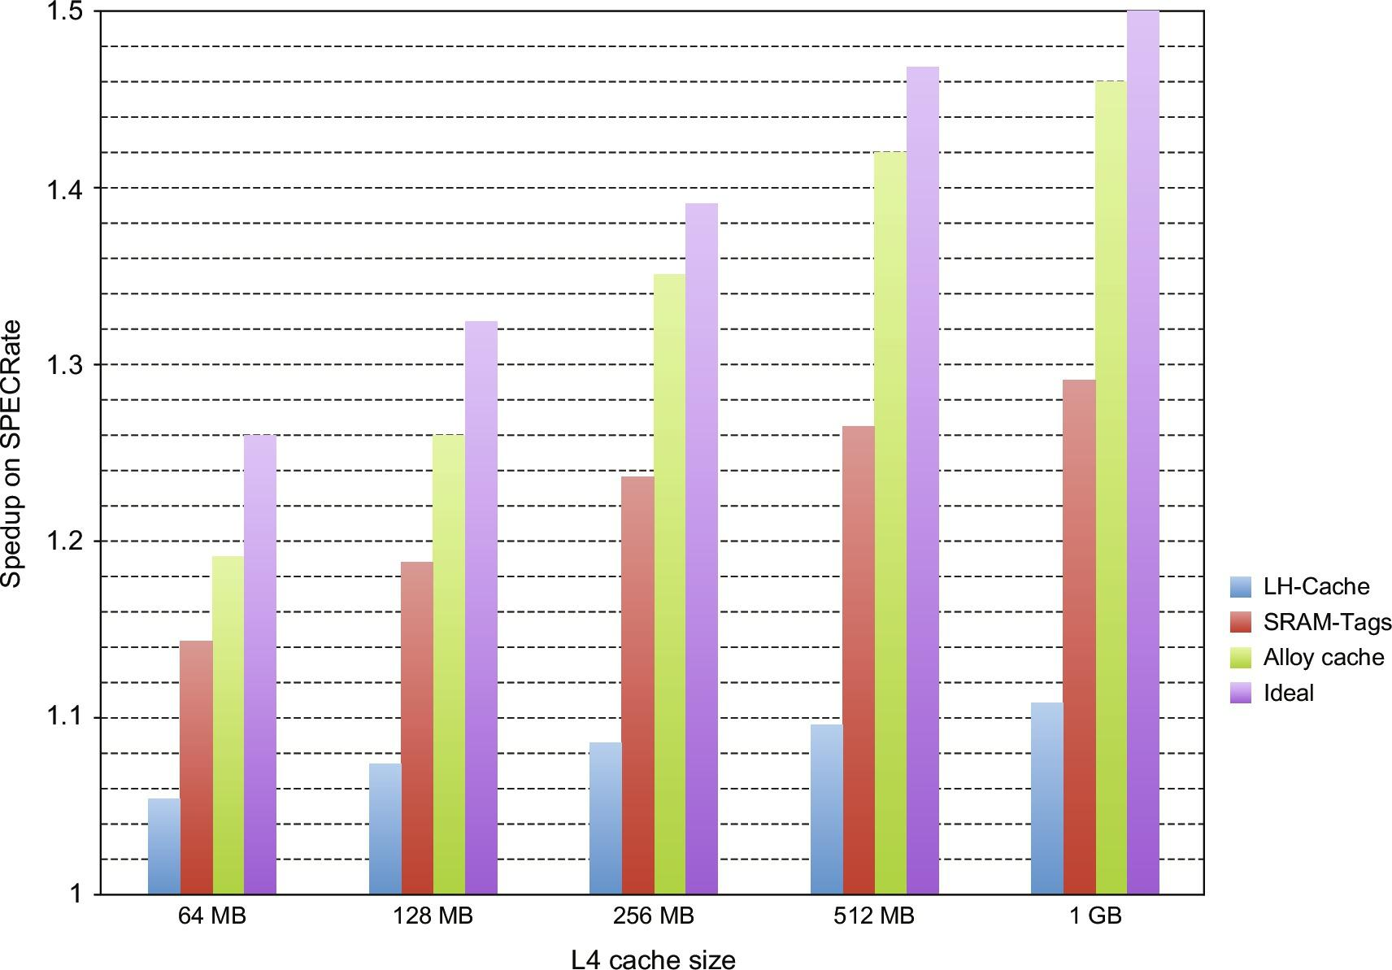
Use HBM to Extend Hierarchy
Advanced Optimizations

Slide 66
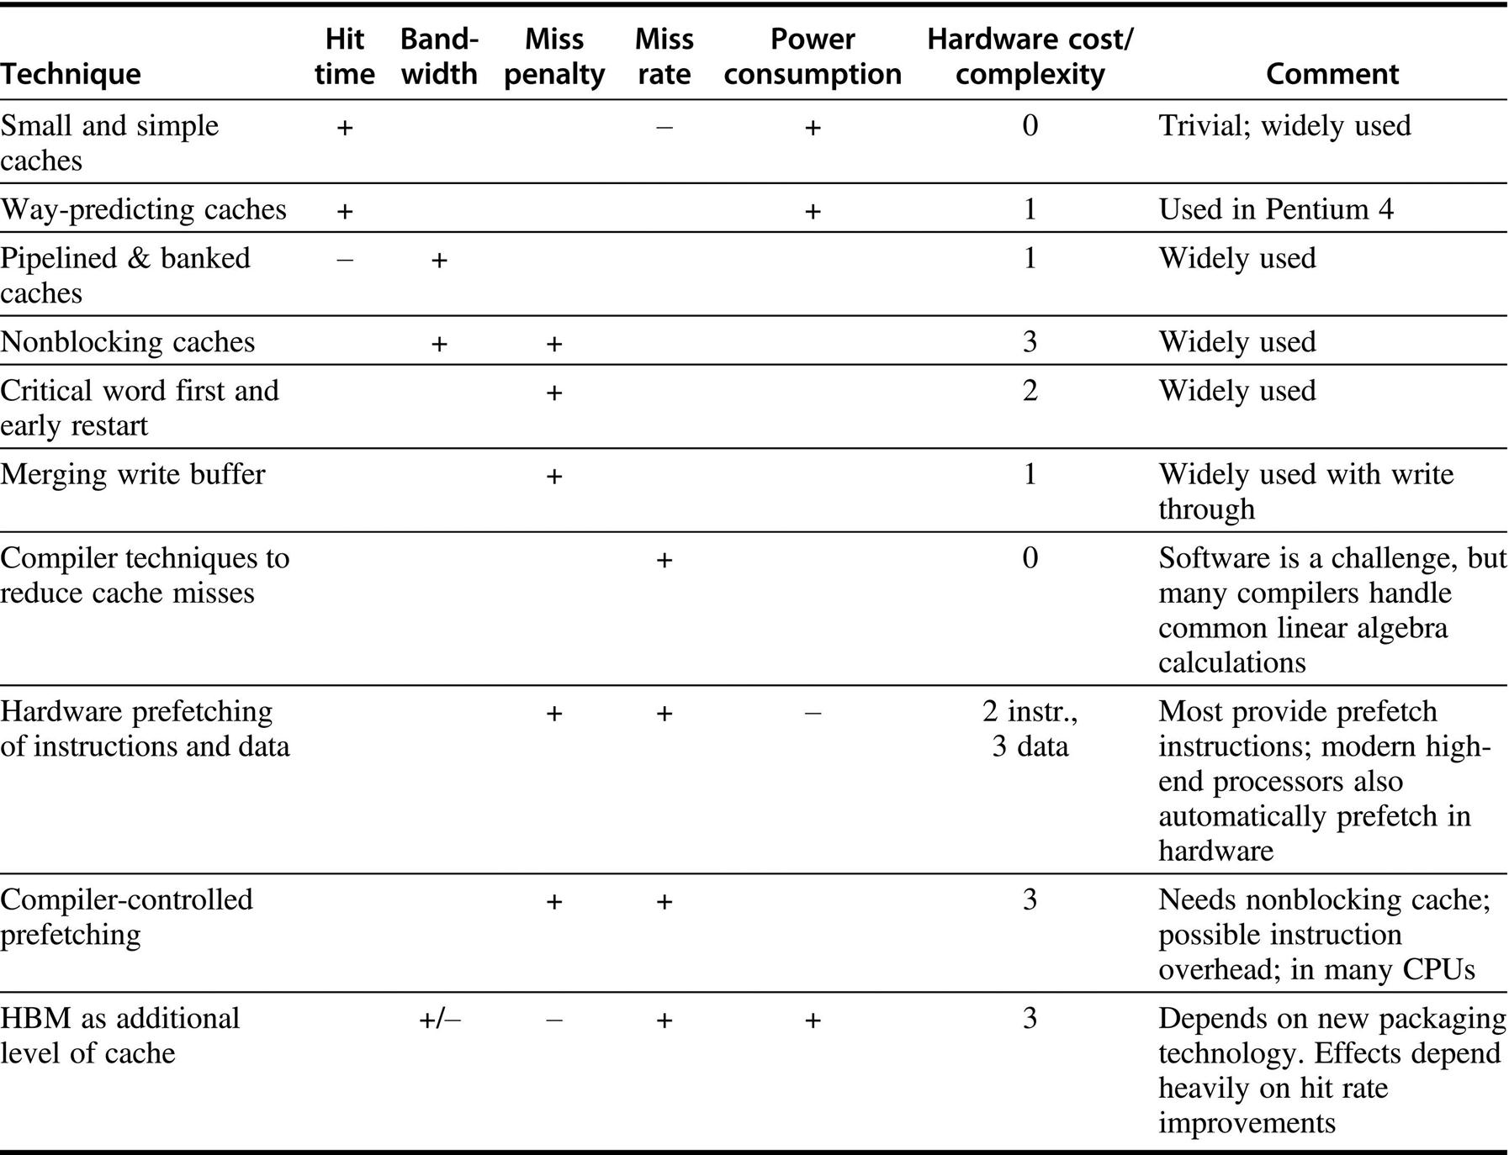
Summary
Advanced Optimizations

Slide 67
Memory Technology
Performance metrics
The cache is concerned about Latency
Multiprocessors and I/O care about Bandwidth
Access time
Time between read request and when desired word arrives
Cycle time
Minimum time between unrelated requests to memory
DRAM used for main memory
High capacity, low cost, medium latency, volatile
SRAM used for cache
Low latency, low capacity, medium cost, volatile

Slide 68
Memory Technology
SRAM
Requires low power to retain bit
Requires 6 transistors/bit
DRAM
Must be re-written after being read
Must also be periodically refreshed
Every ~ 8 ms
Each row can be refreshed simultaneously
One transistor/bit
Address lines are multiplexed:
Upper half of address: row access strobe (RAS)
Lower half of address: column access strobe (CAS)

Slide 69
Memory Technology
Amdahl:
Memory capacity should grow linearly with processor speed
Unfortunately, memory capacity and speed has not kept pace with processors
Some optimizations:
Multiple accesses to same row
Synchronous DRAM
Added clock to DRAM interface
Burst mode with critical word first
Wider interfaces
Double data rate (DDR)
Multiple banks on each DRAM device

Slide 70
Memory Optimizations
Reducing power in SDRAMs:
Lower voltage
Low power mode (ignores clock, continues to refresh)
Graphics memory:
Achieve 2-5 X bandwidth per DRAM vs. DDR3
Wider interfaces (32 vs. 16 bit)
Higher clock rate
Possible because they are attached via soldering instead of socketted DIMM modules

Slide 71
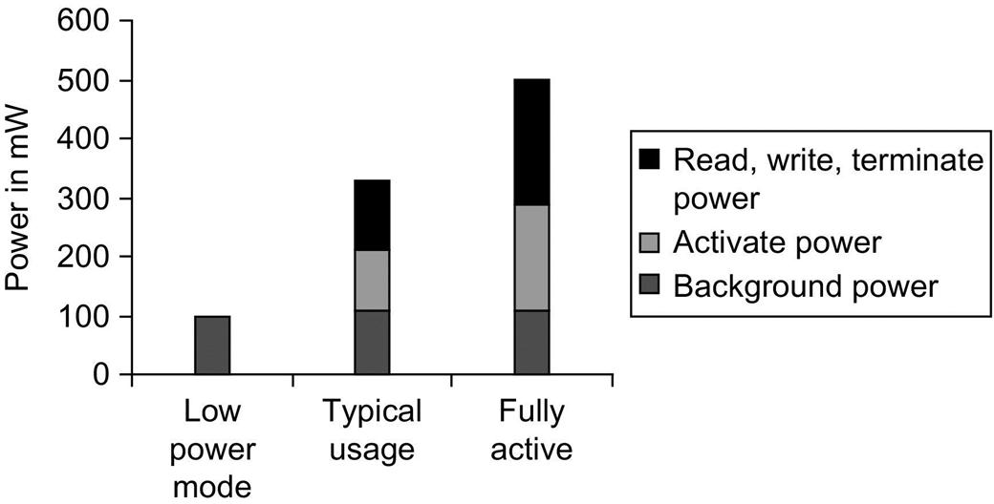
Memory Power Consumption

Slide 72
Stacked/Embedded DRAMs
Stacked DRAMs in same package as processor
High Bandwidth Memory (HBM)

Slide 73
Flash Memory
Type of EEPROM
Types: NAND (denser) and NOR (faster)
NAND Flash:
Reads are sequential, reads entire page (.5 to 4 KiB)
25 us for first byte, 40 MiB/s for subsequent bytes
SDRAM: 40 ns for first byte, 4.8 GB/s for subsequent bytes
2 KiB transfer: 75 uS vs 500 ns for SDRAM, 150X slower
300 to 500X faster than magnetic disk
Must be erased (in blocks) before being overwritten
Nonvolatile, can use as little as zero power
Limited number of write cycles (~100,000)
$2/GiB, versus $20-40/GiB for SDRAM and $0.09 GiB for magnetic disk
Phase-Change/Memrister Memory
Possibly 10X improvement in write performance and 2X improvement in read performance

Slide 74
Memory Dependability
Memory is susceptible to cosmic rays
Soft errors: dynamic errors
Detected and fixed by error correcting codes (ECC)
Hard errors: permanent errors
Use spare rows to replace defective rows
Chipkill: a RAID-like error recovery technique
Memory Technology and Optimizations

Slide 75
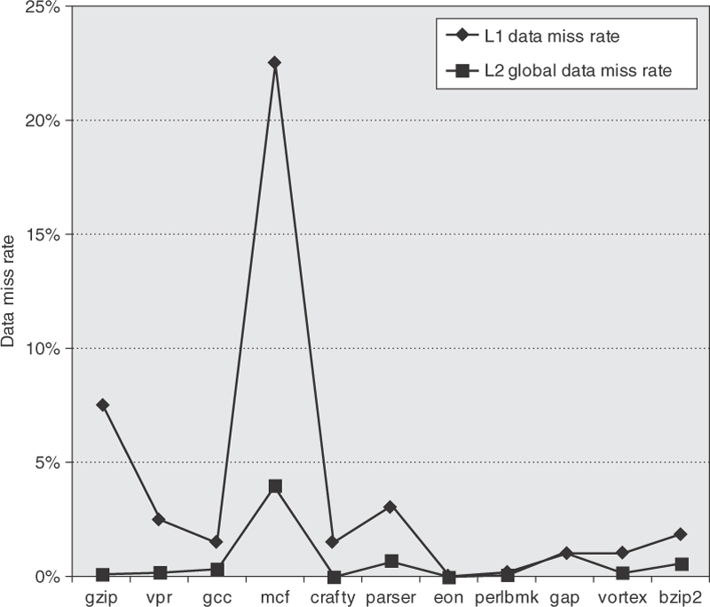
Real Stuff: ARM Cortex-8
Single core, 2 instr/clock
L1 (separate for I & D)
16KB or 32KB
4-way set associative
Way prediction
Random replacement
L2 (Integrated (unified))
128KB to 1 MB
8-way set associative
Notes:
Figure 2.17 The data miss rate for ARM with a 32 KB L1 and the global data miss rate for a 1 MB L2 using the integer Minnespec benchmarks are significantly affected by the applications. Applications with larger memory footprints tend to have higher miss rates in both L1 and L2. Note that the L2 rate is the global miss rate, that is counting all references, including those that hit in L1. Mcf is known as a cache buster.
ARM Cortex-A8 website shows cache in pictures, calls L2 Integrated, and L1 Instruction and L1 Data Caches.

Slide 76
Real Stuff: Intel Core i7
4 cores, 4 instr/clock – out of order (per core)
Caches:
Write-back
64 byte blocks
Non-blocking
L1 has merging write buffer
Characteristic | L1 (per core) | L2 (per core) | L3 (shared)
Size | 32 KB I 32 KB D | 256 KB | 2 MB / core
Associativity | 4-way I 8-way D | 8-way | 16-way
Access Latency | 4 cycles pipelined | 10 cycles | 35 cycles
Replacement Scheme | Pseudo-LRU | Pseudo-LRU | Pseudo-LRU (w ordered selection)

Slide 77
Virtual Memory and Virtual Machines
Protection via virtual memory
Keeps processes in their own memory space
Role of architecture
Provide user mode and supervisor mode
Protect certain aspects of CPU state
Provide mechanisms for switching between user mode and supervisor mode
Provide mechanisms to limit memory accesses
Provide TLB to translate addresses
Virtual Memory and Virtual Machines

Slide 78
Virtual Machines
Supports isolation and security
Sharing a computer among many unrelated users
Enabled by raw speed of processors, making the overhead more acceptable
Allows different ISAs and operating systems to be presented to user programs
“System Virtual Machines”
SVM software is called “virtual machine monitor” or “hypervisor”
Individual virtual machines run under the monitor are called “guest VMs”
Virtual Memory and Virtual Machines

Slide 79
Requirements of VMM
Guest software should:
Behave on as if running on native hardware
Not be able to change allocation of real system resources
VMM should be able to “context switch” guests
Hardware must allow:
System and use processor modes
Privileged subset of instructions for allocating system resources
Virtual Memory and Virtual Machines

Slide 80
Impact of VMs on Virtual Memory
Each guest OS maintains its own set of page tables
VMM adds a level of memory between physical and virtual memory called “real memory”
VMM maintains shadow page table that maps guest virtual addresses to physical addresses
Requires VMM to detect guest’s changes to its own page table
Occurs naturally if accessing the page table pointer is a privileged operation
Virtual Memory and Virtual Machines

Slide 81
Extending the ISA for Virtualization
Objectives:
Avoid flushing TLB
Use nested page tables instead of shadow page tables
Allow devices to use DMA to move data
Allow guest OS’s to handle device interrupts
For security: allow programs to manage encrypted portions of code and data
Virtual Memory and Virtual Machines

Slide 82
Fallacies and Pitfalls
Predicting cache performance of one program from another
Simulating enough instructions to get accurate performance measures of the memory hierarchy
Not deliverying high memory bandwidth in a cache-based system

